Slide 1
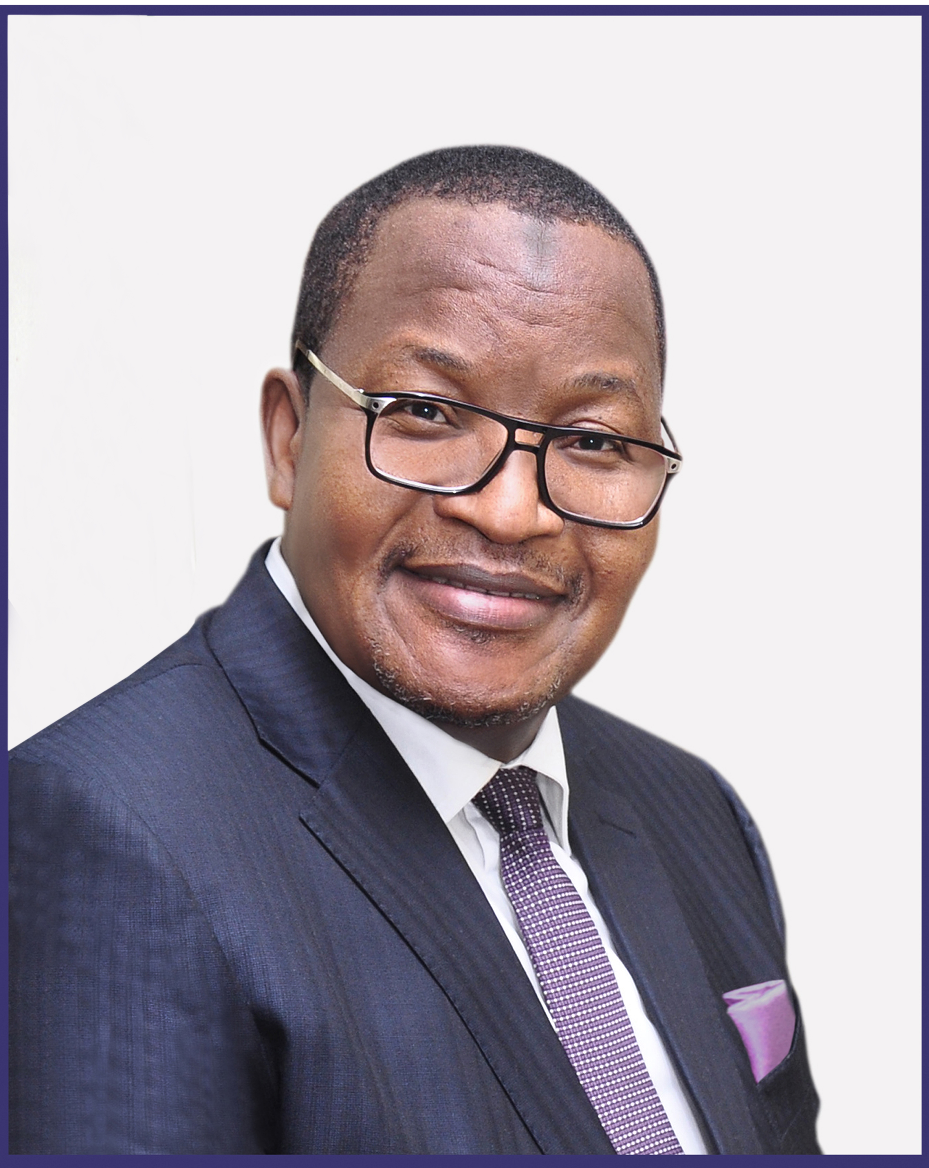
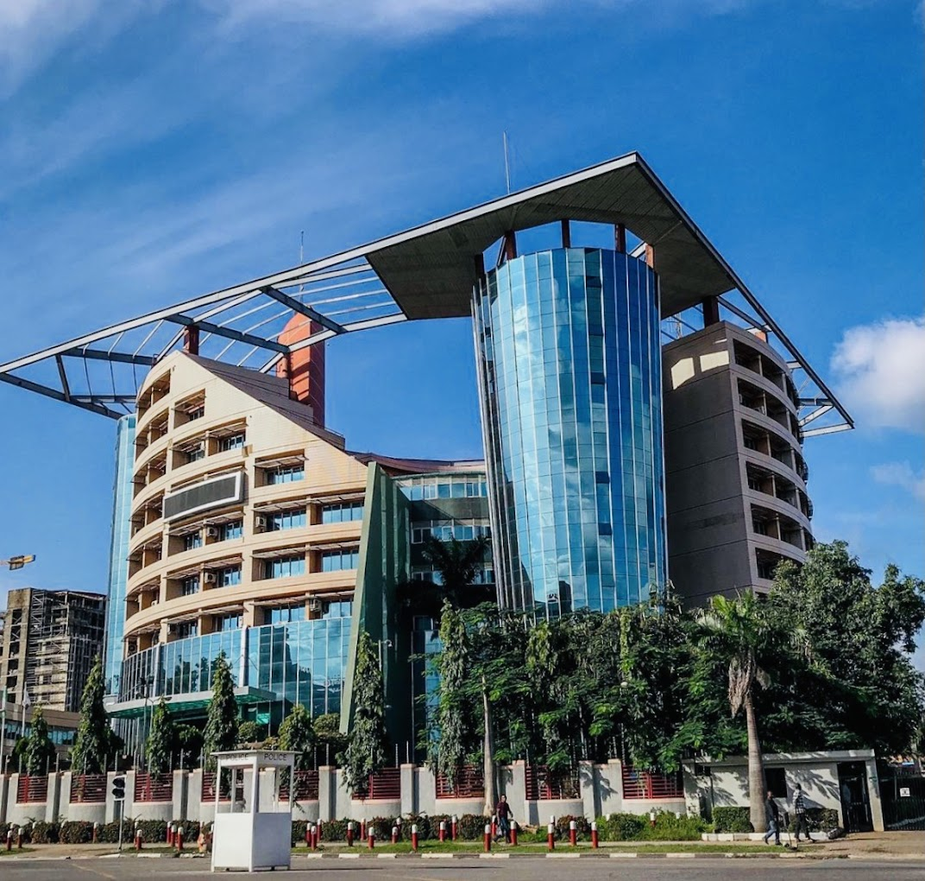
PROF. U.G. DANBATTA, FNSE, FRAES Executive Vice Chairman / CEO NIGERIAN COMMUNICATIONS COMMISSION

Slide 2
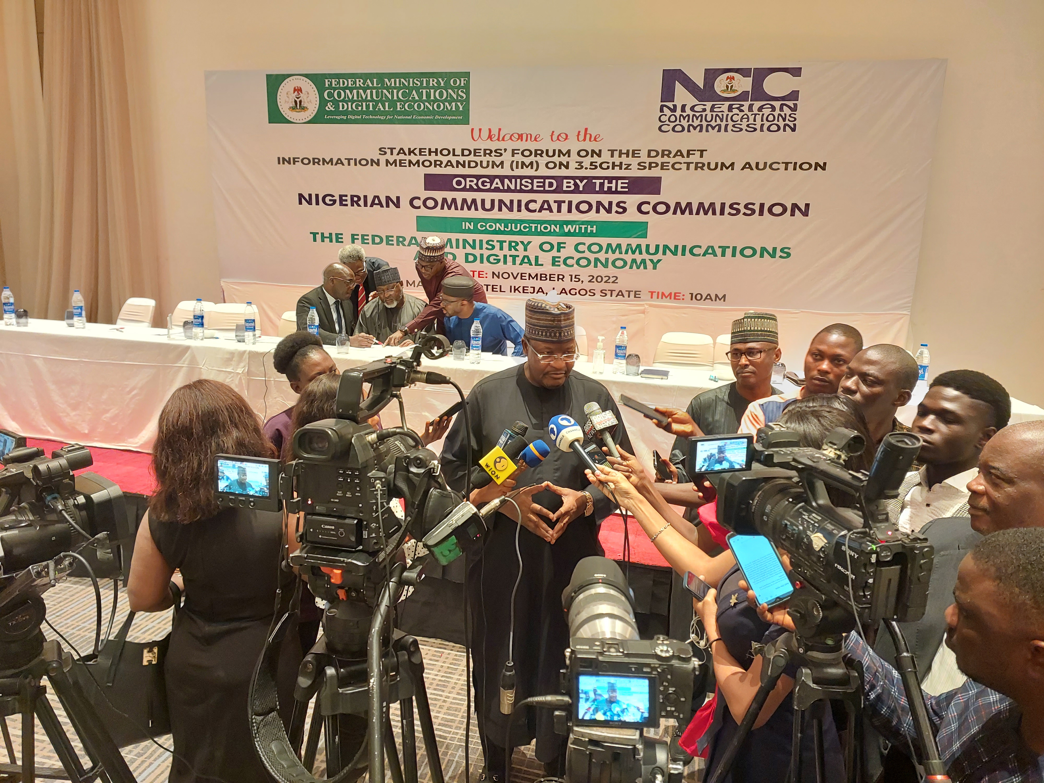
NCC’S STRATEGIC VISION PLANS (SVPs): An Impetus for Nigeria’s Telecoms Sector’s Accelerated Growth (A PRESENTATION TO MEDIA CHIEF EXECUTIVES, EDITORS-IN-CHIEF AND EDITORS) @ The Colossus Hotel, Ikeja, Lagos 5th July 2023

Slide 3
PRESENTATION OUTLINE
1
6
INTRODUCTION
THE 5 PILLARS OF SVP 2
2
7
SITUATION ANALYSIS ON INDUSTRY
MILESTONES OF SVP 2
3
THE STRATEGIC VISION PLAN 2015-2020
(SVP) I
8
INDUSTRY STATS AT A GLANCE
4
9
SCORECARDS OF SVP I
CHALLENGES
5
10
THE STRATEGIC VISION PLAN 2021-2025 (SVP 2)
CONCLUSION

Slide 4
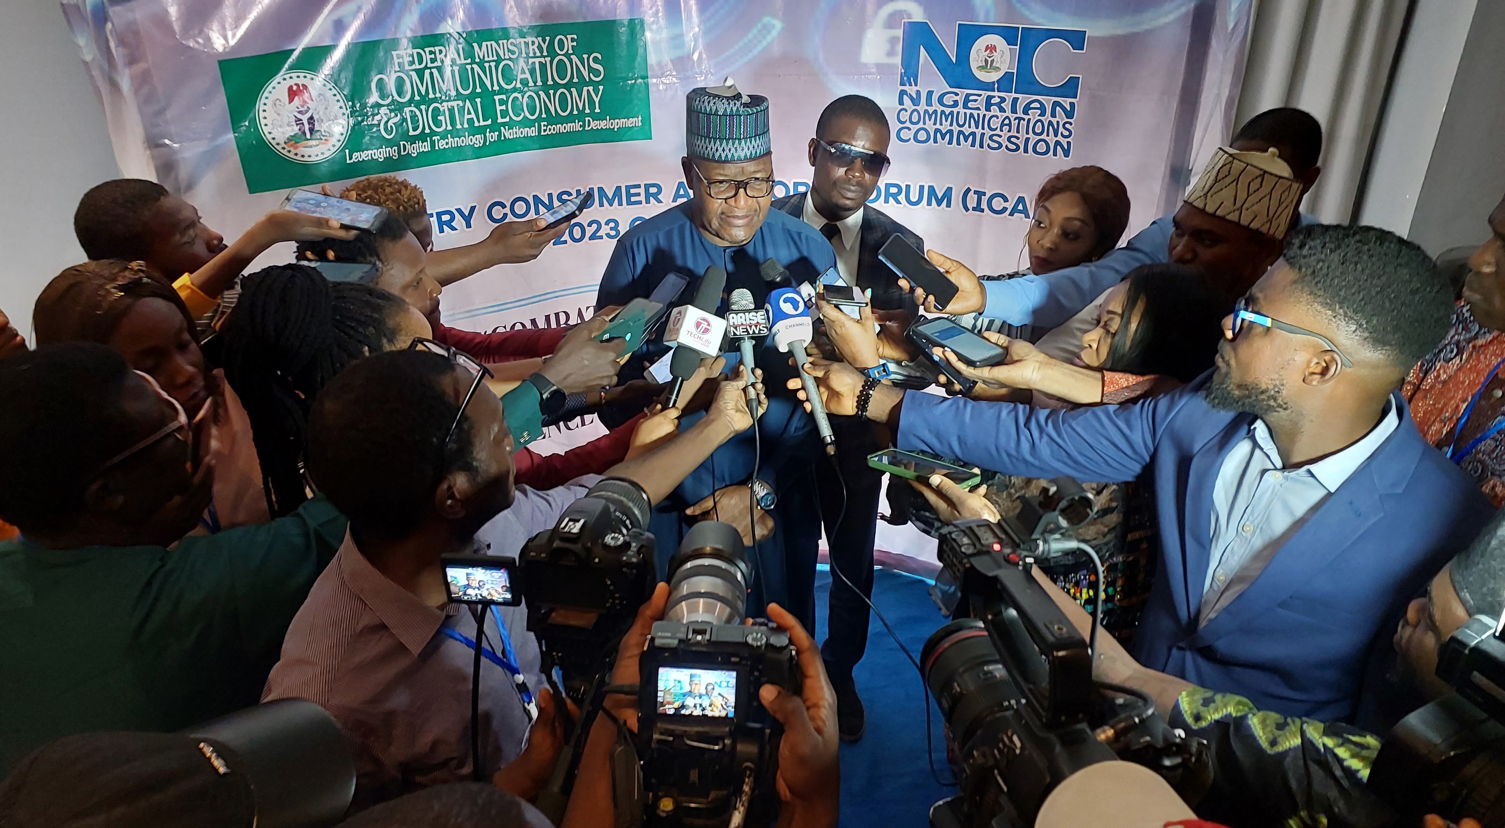
The media remains a strategic partner of the Commission.
INTRODUCTION
As a central stakeholder, the media has been very supportive in the areas of timely, adequate and accurate reporting of the telecoms industry to Commission’s various stakeholders.
2

Slide 5
When I was appointed as the Executive Vice Chairman of NCC in August 2015, Federal Government had embraced broadband as a catalyst for sustainable development. Accordingly, the Government introduced Nigerian National Broadband Plan (NNBP) for the fiscal years 2013-2018.
SITUATION ANALYSIS – AS OF 2015
5

Slide 6
The NNBP is a broadband strategy and roadmap for our country to underscore the strategic nature and importance of broadband. The national target in the NNBP 2013-2018 was to increase broadband penetration from around 6% to 30% from 2013 to 2018. The task of spearheading the national target fell squarely on NCC as the key Driver.
Situation Analysis Cont’d
6

Slide 7
In order to strategically coordinate and align resources and actions to better achieve the mandate of the Commission and facilitate the emergence of a knowledge-based economy in Nigeria, we developed a Strategic Vision Plan (SVP) 2015 – 2020, premised on 8 pillars referred to as the 8-Point Agenda.
STRATEGIC VISION PLAN 2015-2020 (SVP I)
7

Slide 8
In developing the SVP (2015-2020), we leveraged various policy documents, which include: 1. NNBP(2013-2018) 2. NCC’s Strategic Management Plan (SMP) 2014–2018 3. ITU’s Strategic Framework (2013-2018)
The 8-Point Agenda Cont’d
8

Slide 9
THE 8-POINT AGENDA
9

Slide 10
Each of the items in the 8-Point has its focus and targets. Therefore, permit me to present to you our scorecards based on the performance results of each Agenda item under the SVP 1, which we diligently implemented from 2015-2020.
The 8-Point Agenda Cont’d
10

Slide 11
Scorecards of 8-Point Agenda (As December, 2020)
1. Facilitate Broadband Penetration
6 InFraco’s Licensed - Planned to add
38,296 Km of OFC to the Transmission
LTE deployment
Re-planning of 800MHz CDMA
Re-farming part of 1800MHz
Administrative assignment of 700MHz
2.6GHz – 14 Slots Auctioned, MTN (6), Airtel (4) and Open Sky (2)
Guidelines on Commercial Satellite
Communications
Broadband Penetration
increased from 6% (2015) to
45.02% (Nov 2020)
7 VSAT Gateway Earth Stations Licensed to provide
Broadband capacity – MTN (3), Main One (2) & Viasat (2)
Fibre Optic Transmission cables
Increase from 47,000 km to over 54,725 km
Guidelines on use of
TVWS for Broadband deployment
3G & 4G BTS increased
from less than 30,000 to over 53,460
11

Slide 12
2. Improve Quality of Service
Developed and commenced monitoring
of 3G, 4G and CSP QoS KPIs
Acquisition of new QoS monitoring tools
Ongoing collaboration with FMWH
on RoW
Fibre Optic cables increased from
47,000Km to 54,725Km
Deployment of QoS monitoring tools
Assessment of likely QoS impact on Adverts and Promotions
3G & 4G BTS increased
to 53,460 from below 30,000
Clusters of Access gap reduced from 207 – 114 covering ( 33.7M – 31.16M(2019)
12

Slide 13
3. Optimize Usage & Benefit of Spectrum
Spectrum Re-farming; Auctions- Spectrum Fees N144.31Bn N248.399Bn(Fed Account)53 Permits to Geo Stationary (GSO) Satellites ; 923 to Non GSOs.
Remittance of Spectrum Fees into the CRF from 2015 to date
Published Spectrum Trading Guidelines
Development of Licensing Framework
For Emerging Technologies
Permission for MTN to utilize
Visaphone Spectrum for LTE
National Roaming Draft Guidelines
& Trials approval has been granted
Enabled License exempt
use of 60GHz
Ensuring that 26GHz,
34-36GHz is un-encumbered
Preparatory for 5G
Re-channelization of
18/23GHz Microwave spectrum
to cater for large bandwidth
Opening of New Millimeter Wave
Spectrum (mmW) in 70/80GHz
Deployment of spectrum monitoring tools –
Spectrum Analyzers, Fixed and Mobile Monitoring Systems
13

Slide 14
4. Promote ICT Innovation & Investment Opportunities
Use of mandatory Corporate Code
of Governance in the Telecom Industry
Various efforts targeted at reducing
RoW, Multiple Taxation & illegal charges
Telecoms contributions to GDP grew from 8.5% (Q4 2015) to 14.3% Q2 2020
Numerous Grants & Subsidies
Expended through USPF & NCC Projects
Enabled trials for 5G network test
(1st in Sub-Saharan Africa)
Undertaken Mediations
& Obtained Waivers
Funded Telecom Research & instituted Professorial Chairs
Organized various Hackathons
& Competitions
14

Slide 15
5. Facilitate Strategic Collaboration and Partnership
Engagements with the NGF
that resulted in reduced RoW
Ongoing engagements with ITU/ CTO/ WATRA/ ATU/GSMA etc.
Dispute Resolution
47 BTSs Unsealed in Ogun State
N221m RoW charges waved for MTN in Kano
More than 15 BTSs unsealed in Kogi State
Collaboration and MoU with Law Enforcement
and Security and other Government Agencies
Various efforts with other regulators
such as Swedish Post & Telecom
Collaboration with NBC that facilitated
the use of MMDS spectrum for LTE –
(2.7058B paid as compensation)
Collaboration with CBN & NDIC
on FINTECH & Mobile Money
Collaboration with NBC that facilitated
the use of 700MHz spectrum for LTE
Granted permission for MNOs
To be licensed by CBN as Payment Service Banks
15

Slide 16
6. Protect & Empower Consumers
Consumer Protection
Direction on Data Roll Over
Direction on Forceful Subscription
Direction on Do Not Disturb Service
Direction on Suspension of SIM registration
Publication of the Consumer Code of Practice
Consumer Empowerment
DND (2442)
MNP
Toll free line (622)
Consumer Education Programmes:
Telecom Consumer Parliament – 89 Editions
Consumer Outreach Programme – 110 Editions
Consumer Town Hall Meetings in Local Languages) – 53 Editions
Ensuring smooth transition
of Etisalat to 9Mobile
Introduction and enforcement
of MNP
Establishment of;
Consumer Web Portal http://consumer.ncc.gov.ng
Email: consumerportal@ncc.gov.ng
Consumer Twitter Account @Consumersncc
DND/Data Rollover/SMS Reduction/112 Emergency Toll free/24 EECs
16

Slide 17
7. Promote Fair Competition & Inclusive Growth
Statistics - Nov. 2020
Tele-density – 108.92%
Active Telephony Subscribers -207,907, 709
Active Internet Subscriptions – 154,878.203
Broadband Penetration – 45.04%
Engagement with States, NGF, and other Agencies on Telecom issues e.g., RoW, Taxation etc.
Establishment of various Committees
To study unfair practices in the industry
Implementation of Accounting
Separation Framework
Continuous publications of
market share to highlight
competition
Approval and monitoring of the
Acquisition of Visafone by MTN
Facilitation of Mobile Money
Activities of MNOs
Trials of National Roaming & 5G
17

Slide 18
8. Regulatory Excellence & Operational Efficiency
Remittances (2015 – 2020)
Spectrum Fees – N144.312B
Operating Surplus – N248.339B
Implementation of Executive Order 001(EO001).
Service delivery timelines are published
on the Commission website
Enforcement of Code of Corporate Governance
Development of new and review of existing regulatory frameworks.
Leadership role of the
Commission in ITU study Groups
& other fora's e.g. CTO, WATRA
Creation of 7 Internal Policies and
Standard Operating Procedures for each department.
Issuance of various
Subsidiary Legislations
Remarkable improvement in
Staff Welfare, Promotions etc.
Trainings, Workshops & Conference
participation by Staff & Mgt.
Increased telecoms contribution to GDP from 8.5% in 2015 to 12.45% in Q4, 2022
Listing of MTN on the Nigerian Exchange Group (NGX) to empower consumers in telecom ownership
18

Slide 19
Meeting and Surpassing the 30% Broadband Penetration by December 2018. We achieved 31.48%.
CENTRAL MILESTONE OF THE 8-POINT AGENDA
19

Slide 20
THE NEW SVP 2021-2025 (THE 5-POINT AGENDA)
A new Strategic Vision Implementation Plan (SVP 2), 2021–2025, also dubbed “The 5-Point Agenda” was unveiled on September 7, 2021.
Like its predecessors, a number of factors and policy statements were considered in developing the 5-Point Agenda
20

Slide 21
The 5 Pillars of SVP I
1
Organizational Renewal for Operational Efficiency and Regulatory Excellence
2
Facilitating the Provision of Infrastructure for a Digital Economy which fosters National Development
3
Promoting Fair Competition, Inclusive Growth, Increased investment and Innovative Services
5
4
Improving Quality of Service (QoS) for Enhanced Consumer Quality of Experience (QoE)
Facilitating Strategic Collaboration and Partnership
21

Slide 22
Organizational Renewal for Operational Efficiency and Regulatory Excellence
Auction/Launch of 5G services: US$820.8M to FG and Revenue Assurance Solution (RAS)
Development of new and review of existing regulatory frameworks for effective regulation of the industry
Increased Telecom contribution to the GDP. Industry recorded 14.13% contribution in the Q1 of 2023 valued at N2.508tr.
Regular compliance monitoring and enforcement activities to tackle anticompetitive practices.
Aligning regulatory initiatives with the National Digital Economy Policy & Strategy (NDEPS) 2020-2030.
Issuing 26 Mobile Virtual Network Operator (MNVO) Licences.
Improvement on Internal Policies implementation and Standard Operating Procedure (SOP) to improve internal processes.
Leadership role at International telecoms bodies (Nigeria’s reelection as ITU Council Member in 2022; providing leadership at the level of CTO, ATU and WATRA
Staff Up-skilling and digital skill development for Nigerian youth (Capacity building across geo-political zones)
Opening up spectrum bands (i.e. the 60 GHz V-band and 70/80GHz E-band)
22

Slide 23
Facilitating the Provision of Infrastructure for a Digital Economy which fosters National Development
Innovative regulatory elements designed to improve digital infrastructure deployment in Nigeria.
Driving the implementation of Nigerian National Broadband Plan 2020 – 2025 was launched on the 10th March 2020. Target is to achieve 70% broadband penetration by end of 2025.
Broadband Penetration 2023 Q1 (91.8M Subs – 48.14% (NNBP 2025 Target:70%)
Support the deployment of optic fibre cable using the infrastructure company (InfraCo) Project under the Open Access Model: 38,000Km fibre being deployed under InfraCo Initiative
Licensing of Elon Musk’s Starlink to provide wider service coverage across the country, towards a more accessible, available and affordable broadband services in Nigeria.
Provision of Wireless Cloud Infrastructure in 219 tertiary institution and issuing of landing permits to 52 Satellite Operators
Licensing 3.5Ghz spectrum licences to 3 operators (MTN, MAFAB & Airtel) to deploy 5G network, generating over $820.8 million (About N378 billion).
5G services available in different locations in 12 states of the Federation with over 60,000 subscriptions so far.
Construction/Activation of 27 functional Emergency Communications Centre (ECCs). More than 7 of these upgraded to IP-based platform. Four (4) to be added before end of July, 2023.
Expansion of Internet Exchange Point of Nigeria (IXPN) Routes (provided interconnectivity and internet capacity between 5 Data Centres of the IXPN, located in Abuja, Lagos, Kano, Port Harcourt, and Enugu.)
Boost in Offshore Broadband Capacity to 50.74 TB:
23

Slide 24
Promoting Fair Competition, Inclusive Growth, Increased investment and Innovative Services
Leveraging global ICT conferences (i.e. ITU Digital World, GITEX, LEAP Tech Conference in Riyadh in 2021 & 2022, Saudi Arabia, Mobile World Congress etc.) to woo investors into Nigeria’s telecom sector.
Investment profile US$75 Bn (From US$38Bn in 2015)
Regular consumer outreach programmes - NCC’s Consume Conversation Initiatives; Telecom Consumer Parliament etc.
Reduction in RoW cost and ongoing collaborations with the Nigerian Governors Forum (NGF).
More Spectrum Opened/ 26 MVNOs Licensed
Implementation of 100% last-mile connectivity to tertiary institutions in Nigeria
Over N600m spent Telecoms Research, Professorial Chairs and MSMEs initiatives (i.e 7 professorial chairs endowed different universities
Addressing issue of multiple taxations and multiple regulations in the industry
Building Digital Parks across the six geo-political zones of the country.
Digital capacity, literacy & entrepreneurship training for youths across the country
Involvement of young people in indigenous telecom innovation (Over 165 indigenous Tech and start-ups have been provided with support via the Commission’s ICT Innovation and Competition events/Hackathon initiatives .)
Q1 2023 GDP 14.13% (N2.508Bn – (NBS)
Provided sponsorship for young local innovators to ITU Telecom Worlds in Thailand & South Korea
Though NODITS, the Commission is promoting local innovations through the Nigerian Telecom Indigenous Content Expo (NTICE 2022 – The Maiden Edition) August 2022, among others.
24

Slide 25
Improving Quality of Service (QoS) for Enhanced Consumer Quality of Experience (QoE)
Reduction of Access gaps to 97, making more consumers have access to telecoms services
Approved harmonised short codes (HSC) for providing certain services to telecom consumers in Nigeria effective from May 17, 2023
Regular Consumer Outreach Programmes (i.e. NCC Consumer Conversation Initiatives; TCP, and so on.)
Enforcement of various consumer-centric Directions aimed at protecting the consumers.
Finalising activities on the implementation of Device Management System (DMS).
Developing Initiatives with Industry Stakeholders through ICAF to address cases of Electronic Frauds.
Promoting Infrastructure Sharing framework among telecom operators
Ongoing review of consumer-centric regulations - Draft Regulations on Competition Practices; Quality of Service Regulations; Corporate Code of Governance; Data Protection Guidelines; Commercial Satellite Guidelines and Numbering Plan Regulations, among others
Established Computer Security Incident Response Team (CSIRT) to protect the consumers.
Regular Monitoring Quality of Service (QoS) KPIs on mobile networks.
Monitoring implementation of DND, Toll-Free Number 622; Emergency Number 112
MVNO Licence issuance to address issue of unserved and underserved areas in the country.
25

Slide 26
Facilitating Strategic Collaboration and Partnership
Increase Collaboration with different organizations on various levels with a view to achieving the mandates of the Commission. These include:
CBN,
ICPC,
FCCPC,
ONSA,
NSCDC,
FIRS,
NBC,
NLRC,
FCCPC and
MEDIA, so on
26

Slide 27
Industry Statistics At a Glance (As of May 2023)
221.3m
Active voice subscriptions
115.91%
Teledensity
159.6m
Active Internet Subscriptions
48.28%
Broadband Penetration
92.2m
Broadband Subscriptions
14.13%
Telecom GDP contribution by Q1 2023
27

Slide 28
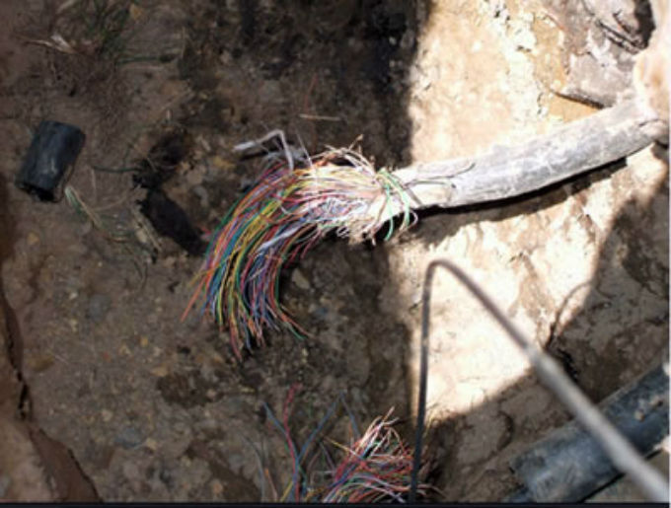
INDUSTRY CHALLENGES
In spite of the ongoing implementation of the 5-Point Agenda and other policy documents, the following critical challenges bedeviling the industry have major impact/effect on the telecommunications services provision and the Commission is working with stakeholders to address them:
Quality of Service (QoS)
Multiple Taxation and Regulations
Right of Way (RoW) issues
Power Supply
Damage to telecommunications Infrastructure
during road construction
Vandalism
Insecurity
28

Slide 29
CONCLUSION
The telecom environment requires a regulatory climate that is predictable, innovative, dynamic, and visionary, to be able to meet, and even surpass the demands of the current economic, social, and environmental demands of all stakeholders, especially with regards to availability, accessibility and affordability.
The Commission is committed to strengthening collaboration with the media as an important stakeholder towards achieving the digital economy targets of the Federal Government.
29

Slide 30
My colleagues and I are glad to take your questions as well as clarifications you may require.
30

